Slide 1
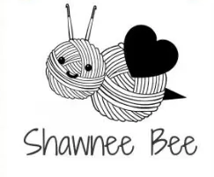
Shawnee Bee
Home
Navigation Bar
Logo
Example photo
About us
Getting started
Likes and dislikes
Mission and vision
Tutorials
Specific stitches
Full products
Shawnee’s Favs
Favorite yarn brands
Favorite pieces made
Favorite other crafters
Purchase
Scarfs
Hats
Shirts
misc
Contact Us
Name
Address
Email
Map
Shopping Cart
Check out

